Slide 1



My Probability Interactive Notebook
Name
Class
Teacher Mr Evans
Term 2 Semester 1
1

Slide 2
Create your own front page
It needs to contain the following –
My number interactive notebook
Name
Class
Teachers Name
Semester 1 Term 1
Page number 1

Slide 3
Contents
Glossary or Formula Page
Page
Date
Description
2
3

Slide 4
Tasks
24
7
30
Essential Question
Questions
Notes
Summary
4
5

Slide 5
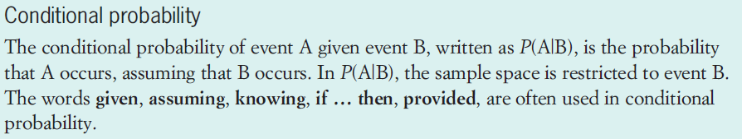
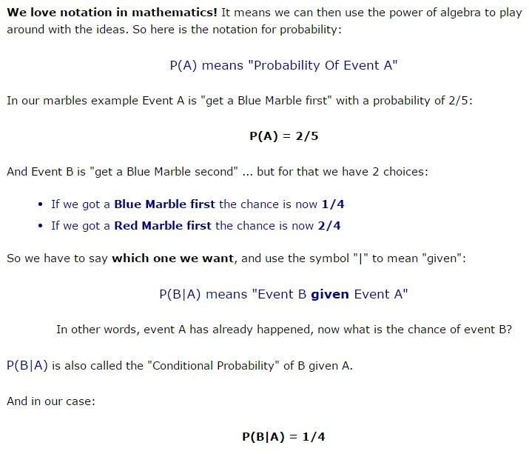
24
7
30
Date
Conditional Probability
EQ – How do we calculate conditional probability?
What is conditional probability?
5

Slide 6
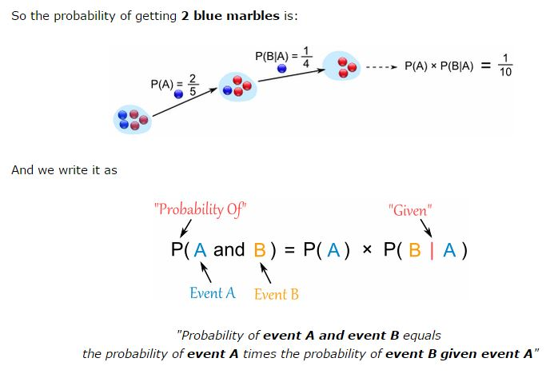
24
7
30
Date
Conditional Probability
EQ – How do we calculate conditional probability?
What is conditional probability?
5

Slide 7
Task
Complete Numbers 1,2 and 6 from pages 256 – 257 in the text book.

Slide 8
Answers

Slide 9
Notes Review
24, 7 ,30
Date
Title
Essential question
Notes complete
Notes complete with colour and diagrams
Questions completed
Contents page filed in
Formula page filled in

Slide 10
Homework
Review your notes and write a summary answering the essential question.

